Slide 1
Carpet Direct 2016

Slide 2
Life Guard by Shaw
FOUNDATION – where we build
MATERIALS – what we build with
PROTECTION – insurance for investment
Notes:
Foundation – any great structure is built on a foundation. The choice of the foundation determines the life of the project/product, and will have a significant impact on how long the structure will be there.
We have chosen to innovate our flooring backing, with LifeGuard. Simply stated it’s the BEST backing we can create and use today. Its impervious to water, giving it a 100% waterproof backing

Slide 3
Notes:
Proprietary technology isn’t anything new to Shaw industries, we continue to innovate for our customers and the consumers.
This new technology creates a waterproof barrier, impervious to any liquid.
Allowing you to have confidence against any spill – protection from it creating odors or wicking

Slide 4
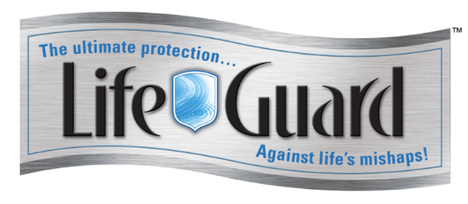
Life Guard by Shaw
Foundation
“the beautiful rest on the foundations of the necessary”
Ralph Waldo Emerson
FOUNDATION – LIFE GUARD
Like soils under a building
Education to a child
Notes:
Where we begin is very important

Slide 5
LifeGuard
Foundation – any structure begins with the foundation. The choice of the foundation determines the life of the project/product, and will have a significant impact on how long the structure will be there.
We have chosen to innovate our flooring backing, with LifeGuard. Simply stated it’s the BEST backing we can create and use today
100% waterproof backing
Lifetime Stain and Soil
Lifetime no Delamination, tuft bind warranties, and no zippering.
20 or 25 year quality assurance warranties (product specific)

Slide 6
LifeGuard
Materials: when a structure is created the choice of materials are vital to the existence of the project/product.
We have chosen our BEST yarn to manufacture with ANSO Nylon
Lasts and looks new longer
Green story – can be recycled into carpet and contains recycled content
Tough- built to last, ANSO has been around for over

Slide 7
Life Guard by Shaw
Materials
Anso nylon:
Green - Cradle to Cradle, Environmentally friendly
Resilient – nylon lasts and looks newer longer
Experience - Tested, Proven, and Requested
Anti soil and stain – R2X
Tough - 25 / 20 year warranties:
Texture retention, Abrasive wear, Quality assurance
Lifetime warranties:
No Delamination, No Wrinkle, No Edge Ravel, Tuft bind
Notes:
Importance to customers today:
Warmth and comfort underfoot
Carpet the cleans easily
Reduction/Elimination of Odors and wicking

Slide 8
LifeGuard
Protection: you now have a built a quality structure on a sturdy foundation. Ho w do you protect this investment?
R2X – patented stain treatment that is from the tip to the root of the fiber. Completely that fiber from life’s messes – inside and out. As you know the R2x is hydrophobic – always pushing away liquid, giving you more time to address the stain, and confidence that it can be easily removed from the carpets.

Slide 9
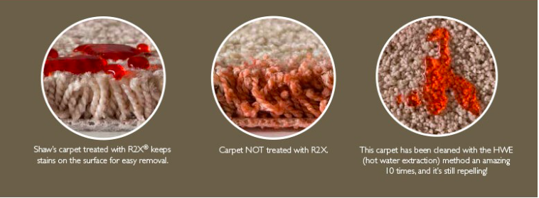
Life Guard by Shaw
Protection
R2X:
Anti - Stain & Soil
Hydrophobic – pushes liquids away
Soiling – allows for soil to easily be removed

Slide 10
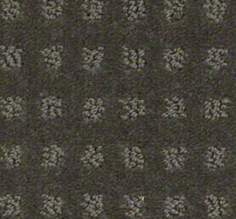
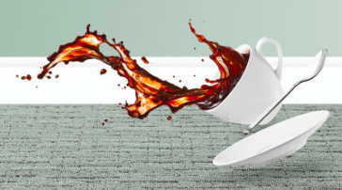
Life Guard by Shaw Fashion – Style – Color
Notes:
Repeatedly in research you will find that a solid foundation is the start to any project, if what is built on that foundation will result in a longer lasting structure.
Do you have an active lifestyle which includes kids and pets yet you want it to be easy to clean?
Do you have parties or entertain with friends and family?
Do you like to enjoy the feel of warmth and comfort under foot that carpet provides?
Would you feel comforted knowing that your cushion and subfloor were protected from everyday spills such as your toddler’s bottle of juice, a glass of wine from the party last night and how about the accidents that your pets may have left you unknowingly?

Slide 11
Life Guard by Shaw Fashion – Style – Color
Everyone of these styles were built to last, and hold up to the punishment from a households toughest messes.
They were also all built with Fashion, Style, and Color in mind.
Expansive color pallets
Delicate patterns and loops
Luxurious textures – solid, heathered, and accent options
Notes:
Repeatedly in research you will find that a solid foundation is the start to any project, if what is built on that foundation will result in a longer lasting structure.
Do you have an active lifestyle which includes kids and pets yet you want it to be easy to clean?
Do you have parties or entertain with friends and family?
Do you like to enjoy the feel of warmth and comfort under foot that carpet provides?
Would you feel comforted knowing that your cushion and subfloor were protected from everyday spills such as your toddler’s bottle of juice, a glass of wine from the party last night and how about the accidents that your pets may have left you unknowingly?

Slide 12
LifeGuard
Example questions to start your sales call with,
Do you have an active lifestyle which includes kids and pets yet you want it to be easy to clean?
Do you have parties or entertain with friends and family?
Do you like to enjoy the feel of warmth and comfort under foot that carpet provides?
Would you feel comforted knowing that your cushion and subfloor were protected from everyday spills such as your toddler’s bottle of juice, a glass of wine from the party last night and how about the accidents that your pets may have left you unknowingly?

Slide 13
Life Guard by Shaw
What questions do you have about this new innovation?
Can someone share a story of how this could benefit their selling story?
Notes:
Repeatedly in research you will find that a solid foundation is the start to any project, if what is built on that foundation will result in a longer lasting structure.
Do you have an active lifestyle which includes kids and pets yet you want it to be easy to clean?
Do you have parties or entertain with friends and family?
Do you like to enjoy the feel of warmth and comfort under foot that carpet provides?
Would you feel comforted knowing that your cushion and subfloor were protected from everyday spills such as your toddler’s bottle of juice, a glass of wine from the party last night and how about the accidents that your pets may have left you unknowingly?

Slide 14
Anso new Intros
Finely detailed
Desirable I, II, III

Slide 15
Stainmaster
Stainmaster TrueSoft
Elegant I, II, III
Fabulous I, II, III
Dazzling I, II, III
Pet Protect
Couture I, II

